Slide 1
Collision Data Analysis - Seattle
Vishal Dongare
September 13, 2020

Slide 2
Introduction
Seattle is well known for its tough driving conditions.
Collision data analysis can produce some useful insights
Helpful to Seattle police and traffic departments
Machine learning model can be built to predict severity of a collision based on various factors, such as weather, road conditions etc.

Slide 3
Data
Sourced from the shared data included in Capstone project
Around 195000 entries and 38 columns
Includes many features, such as severity, location, date, time, various driving conditions, collision types etc.
Unnecessary column were dropped in data cleaning
Missing values were filled by appropriate categorical values

Slide 4
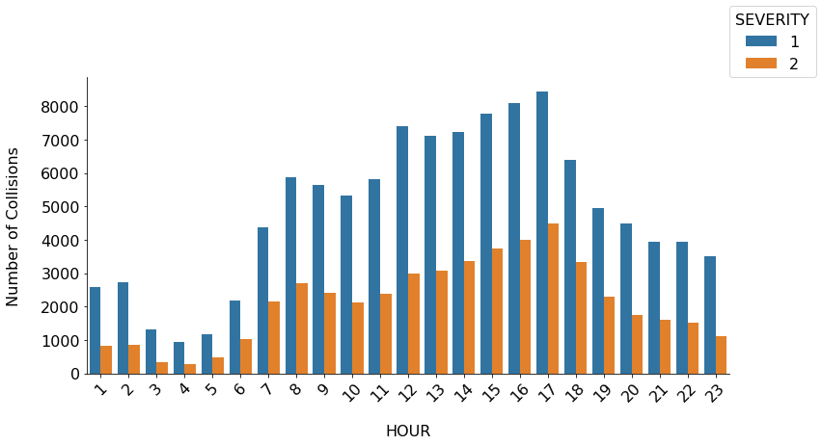
More collisions occur in the afternoon, peak at around 5 pm

Slide 5
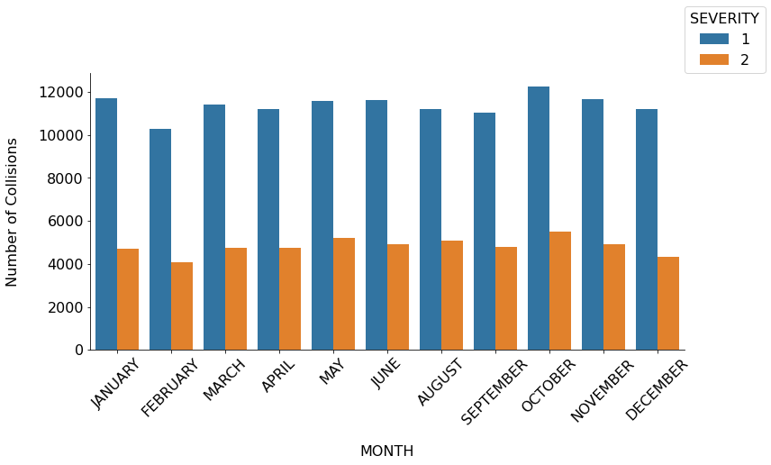
Month has no impact on number of collisions

Slide 6
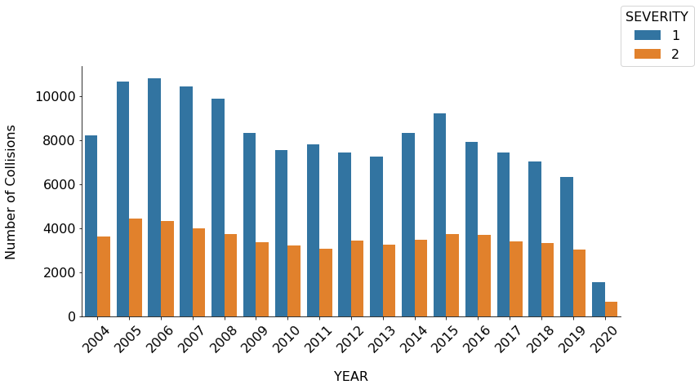
Number of collisions is decreasing year over year

Slide 7
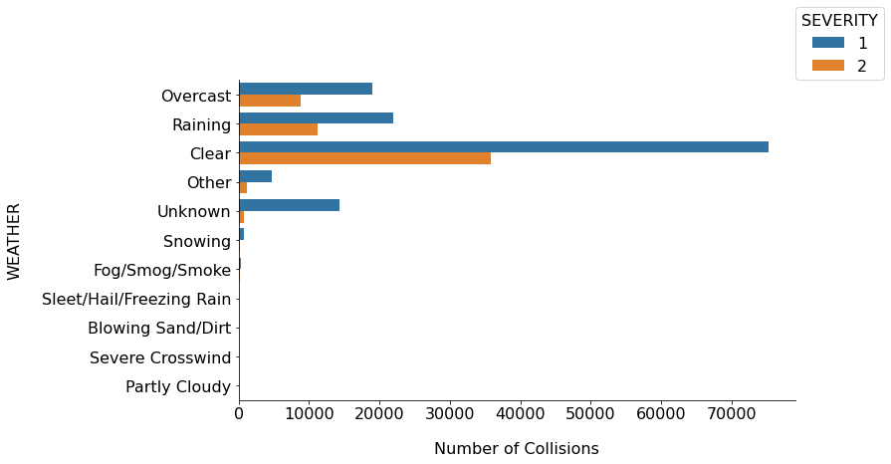
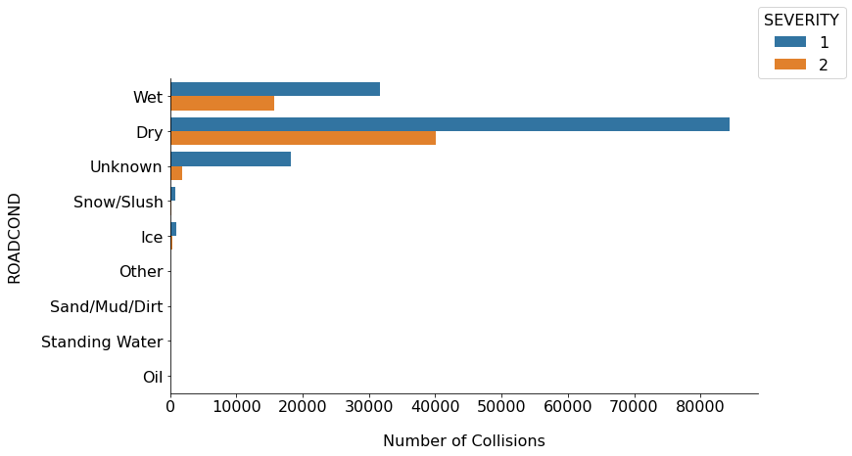
Most collisions occur on clear days and on dry roads

Slide 8
More insights
‘Angled’ and ‘rear-ended’ collision types are more severe
Collisions occurring at the intersection produce severe collisions
Collisions involving pedestrians and bicycles almost always result in severe collisions.
Intersection collisions are more severe resulting in injuries to the people involved

Slide 9
Predictive model
This is a classification problem
To build a model that can predict severity of a collision
Four model were used
1. Logistic regression
2. Random Forest
3. Naïve Bayes
4. Gradient boost
Accuracy, Precision, Recall and F1 score were used as performance evaluation parameters

Slide 10
Results
Models performed poorly in classifying severity 2
 | Logistic regression | Random forest | Naïve Bayes | Gradient boost
Accuracy | 0.76 | 0.75 | 0.73 | 0.76
Precision Severity 1 | 0.77 | 0.78 | 0.80 | 0.77
Recall Severity 1 | 0.95 | 0.91 | 0.83 | 0.95
F1 score Severity 1 | 0.85 | 0.84 | 0.81 | 0.85
Precision Severity 2 | 0.72 | 0.63 | 0.55 | 0.73
Recall Severity 2 | 0.32 | 0.38 | 0.49 | 0.32
F1 score Severity 2 | 0.44 | 0.47 | 0.52 | 0.44

Slide 11
Results after under-sampling
Three Models performed better in classifying severity 2
 | Logistic regression | Random forest | Naïve Bayes | Gradient boost
Accuracy | 0.72 | 0.71 | 0.60 | 0.72
Precision Severity 1 | 0.76 | 0.74 | 0.56 | 0.77
Recall Severity 1 | 0.65 | 0.65 | 0.98 | 0.63
F1 score Severity 1 | 0.70 | 0.69 | 0.71 | 0.69
Precision Severity 2 | 0.69 | 0.68 | 0.92 | 0.68
Recall Severity 2 | 0.79 | 0.76 | 0.21 | 0.81
F1 score Severity 2 | 0.73 | 0.72 | 0.34 | 0.74

Slide 12
Conclusion
Gradient Boost was the overall winner resulting in unbiased predictions with 72 % accuracy.
It produced 4366 false positive prediction and only 2189 true negative predictions which is preferable in this type of classification problem
Other techniques should be considered to deal with unbalanced data
Date and time data can be included in model building
Hyper-parameter tuning can be used to further improve model’s performance

